Slide 1
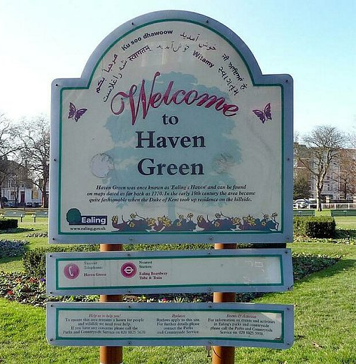

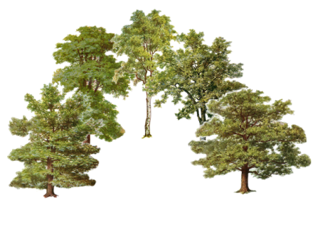
Keeping Haven Green at the Heart of Ealing

Slide 2
FOHG Formed 2011
Aims ...
  ‘to secure the conservation, protection and improvement of Haven Green and its environs as an important place of local historic, architectural, ecological and aesthetic significance and to safeguard the public right to the quiet enjoyment of the Green.’
5 point agenda:
to work with Council authorities who manage Haven Green to:
Maintain and improve the quality of the green environment.
Protect and enhance the historic character of the buildings that surround the Green.
Manage the traffic better and give pedestrians higher priority.
Encourage appropriate recreational activity and curb anti-social behaviour.
Protect the Green as Common Land and an historic Village Green.

Slide 3
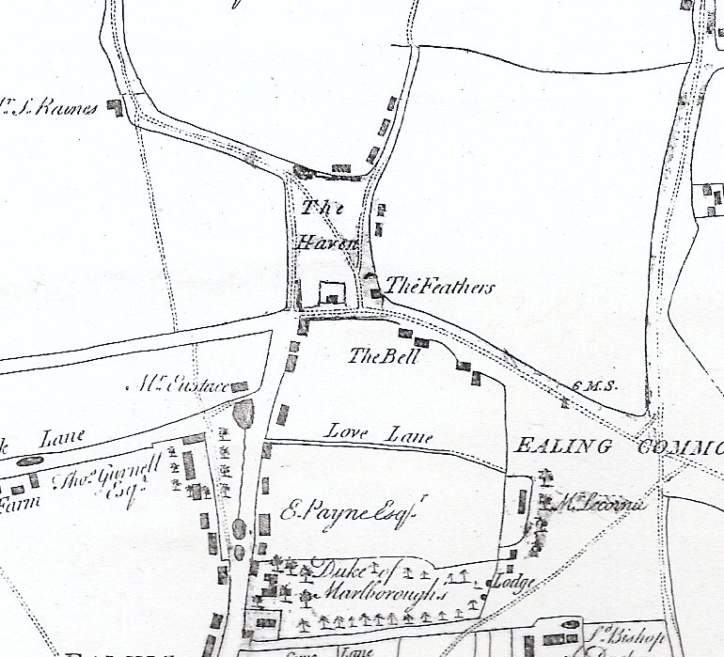
Common land since middle ages
Owned by the Bishops of London.
Old maps show ‘The Haven’ north of the London to Oxford Road arranged much as it is today,.
This was a drovers’ road. The Haven was one of the last stops for sheep on their way to Smithfield.
Maps show The Haven surrounded on three sides by roads. A fourth runs diagonally across it.

Slide 4
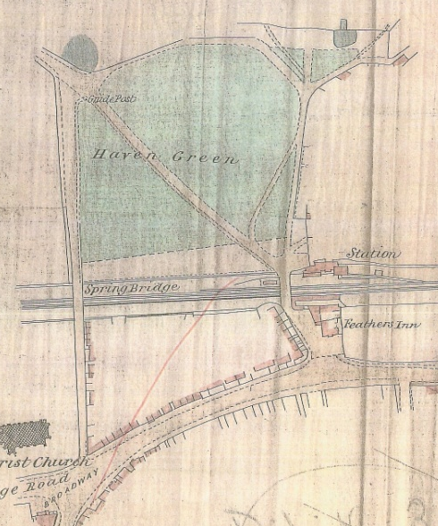
z
In 1838 Brunel’s railway built on the southern half.
Ealing Haven Station built
1878 Church Commissioners handed the Green to Ealing Local Board to manage it as ‘recreation ground’.
Seats were installed and trees planted to make ‘this Green a place of pleasant recreation’.

Slide 5
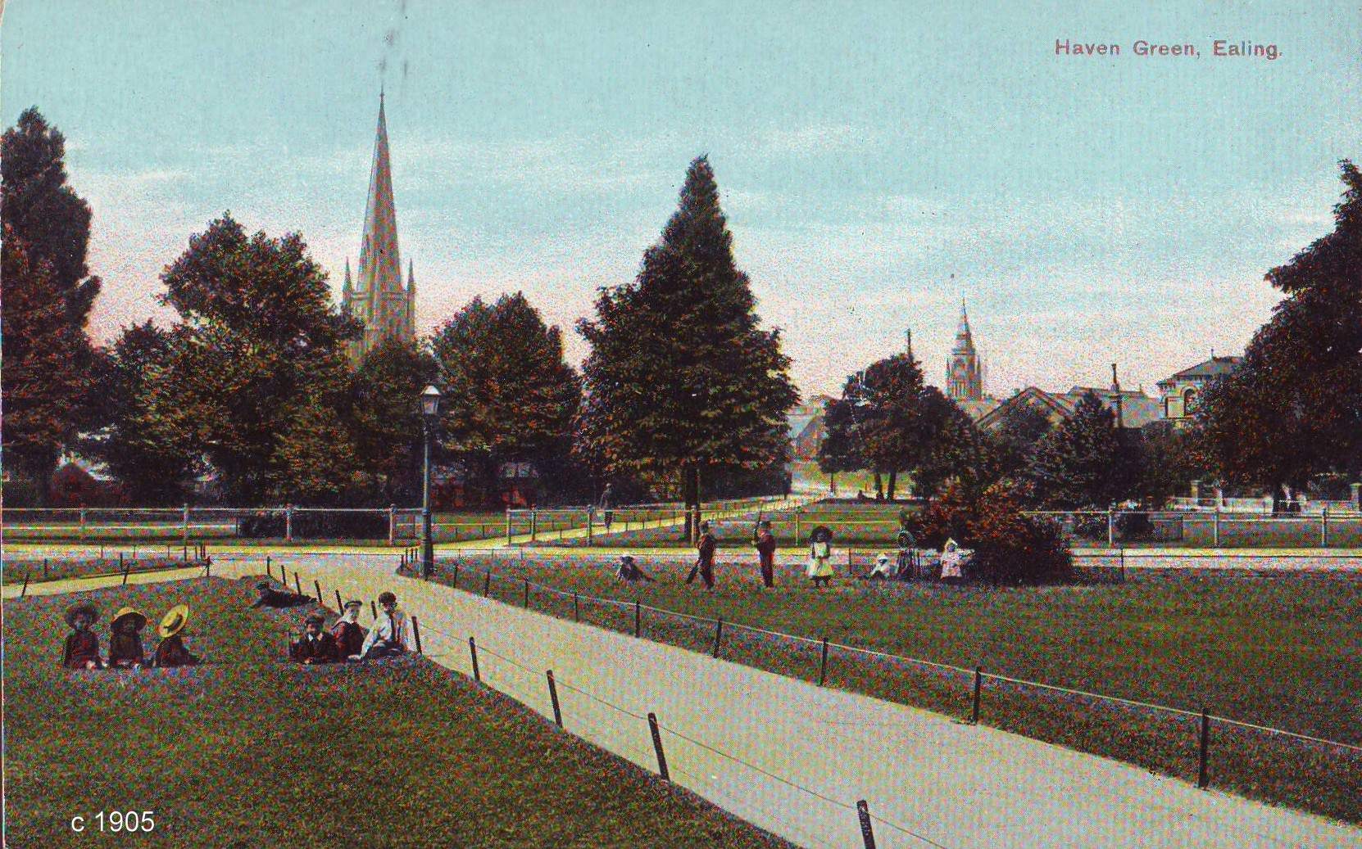
Generally, they achieved this

Slide 6
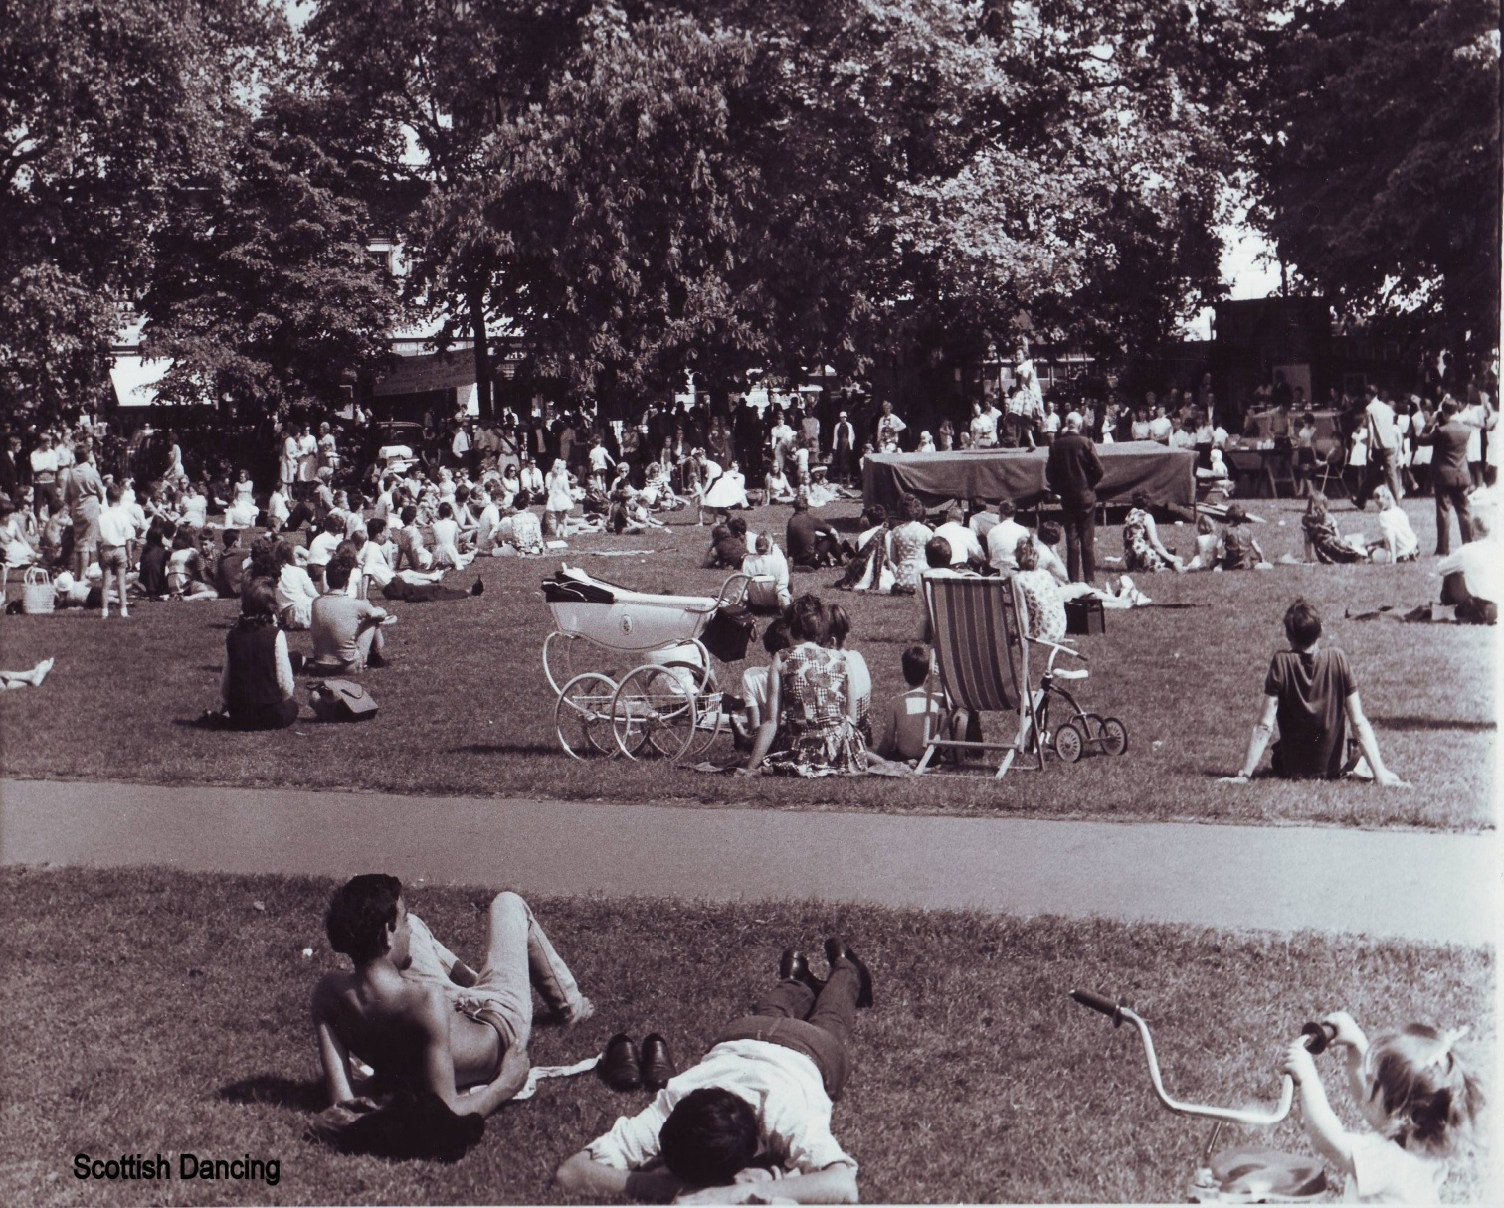

Slide 7
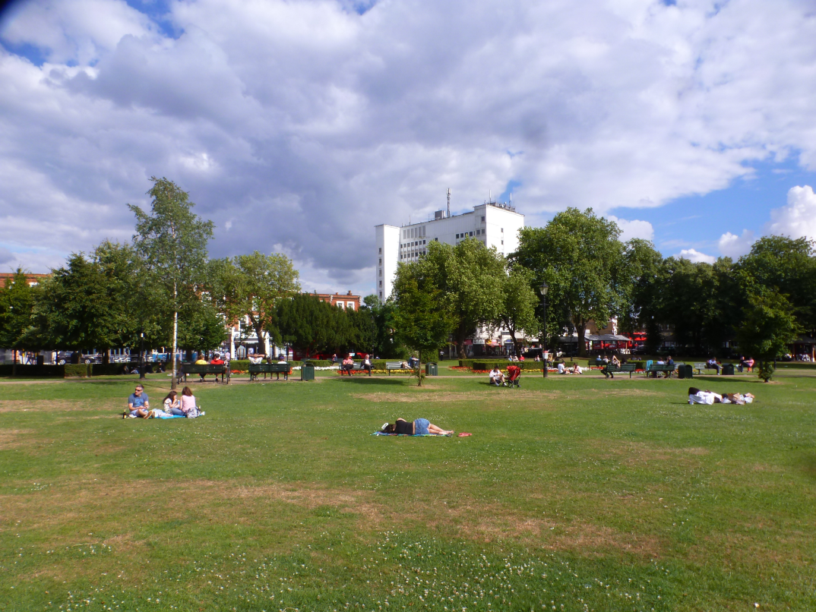

Slide 8
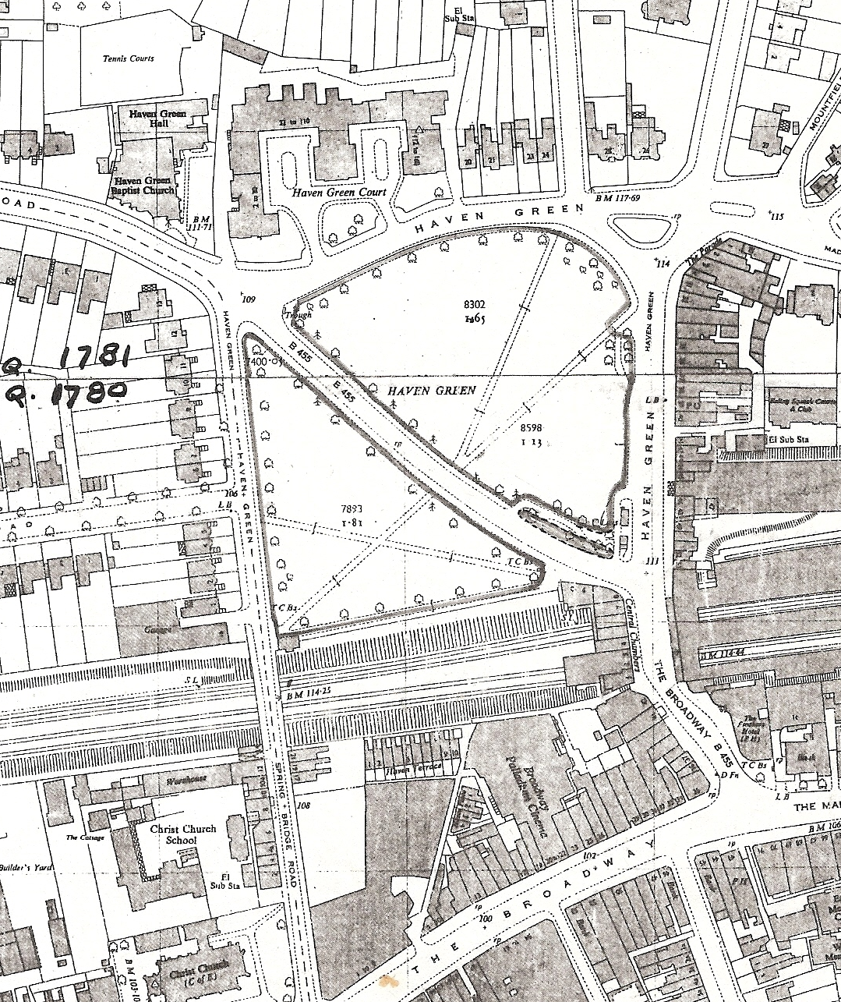
In 1968 Haven Green Registered as Common Land.
In 2009 FoHG made a failed application to register Haven Green a Village Green
2 objections, both by LBE.
Public use was held to be ‘by right’ not ‘as of right’.

Slide 9
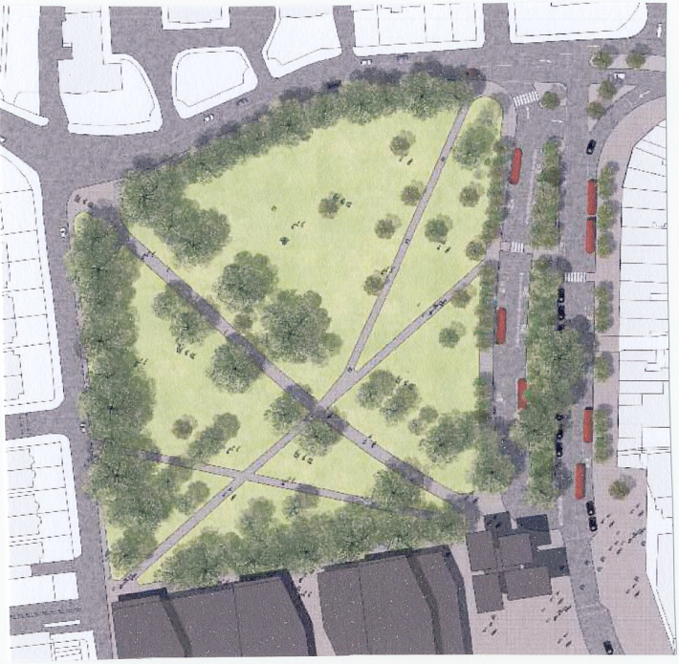
There have always been tensions about the use of the Green.
Fred Perry’s father wrote in 1923:
‘I regret that the Town Council have thought it desirable to destroy partially the beauties of Haven Green by removing the fine row of trees and have also encroached upon the Green in order to undertake the widening of the road.
Since 1967 threats to the Common Land have grown.
A bus station planning application was defeated ...

Slide 10
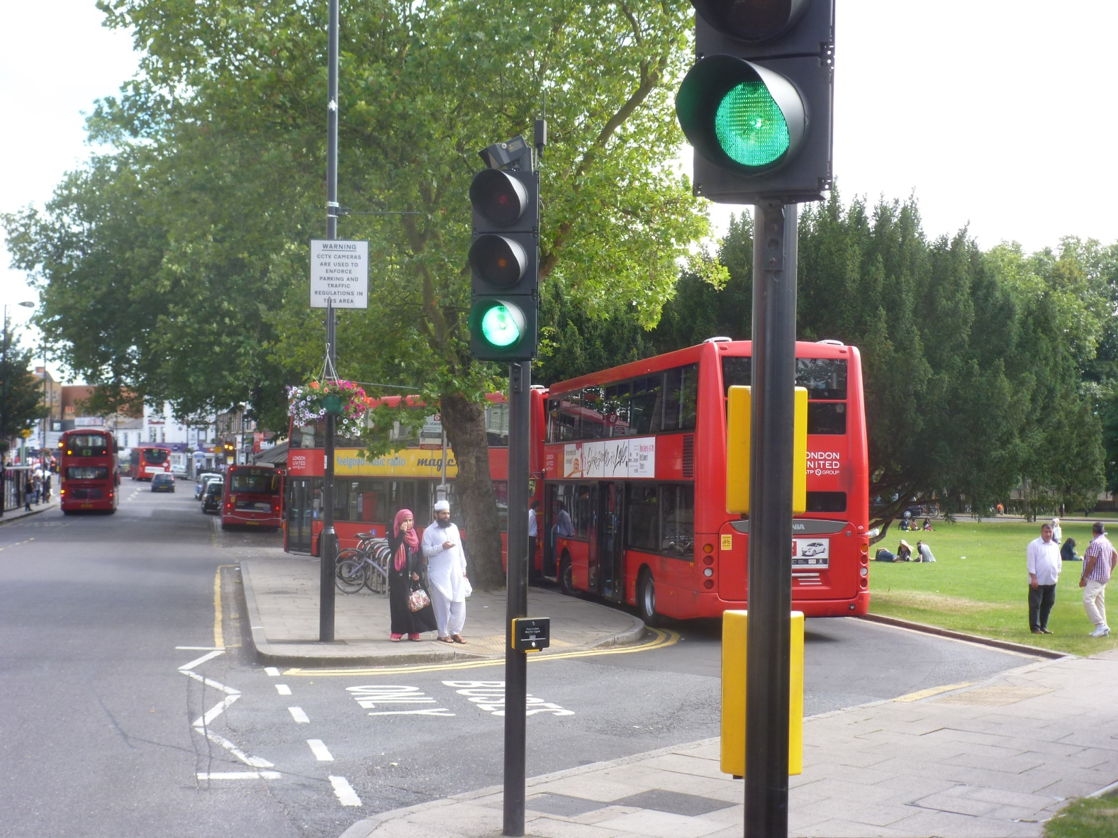
... but land has been lost to a bus layby ...

Slide 11
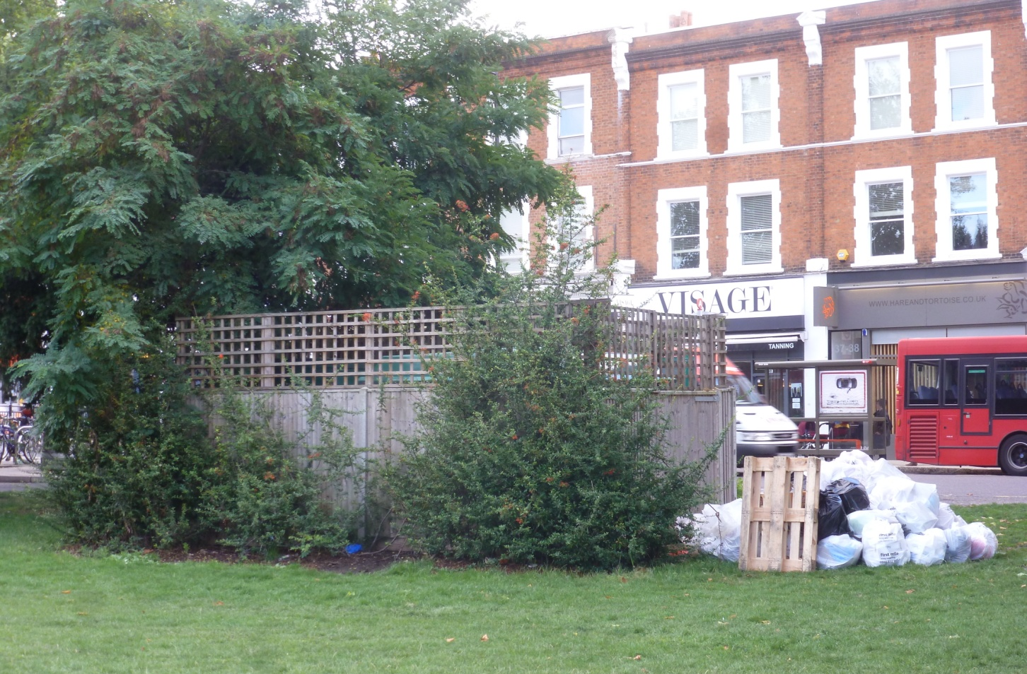
... an electricity substation ...

Slide 12
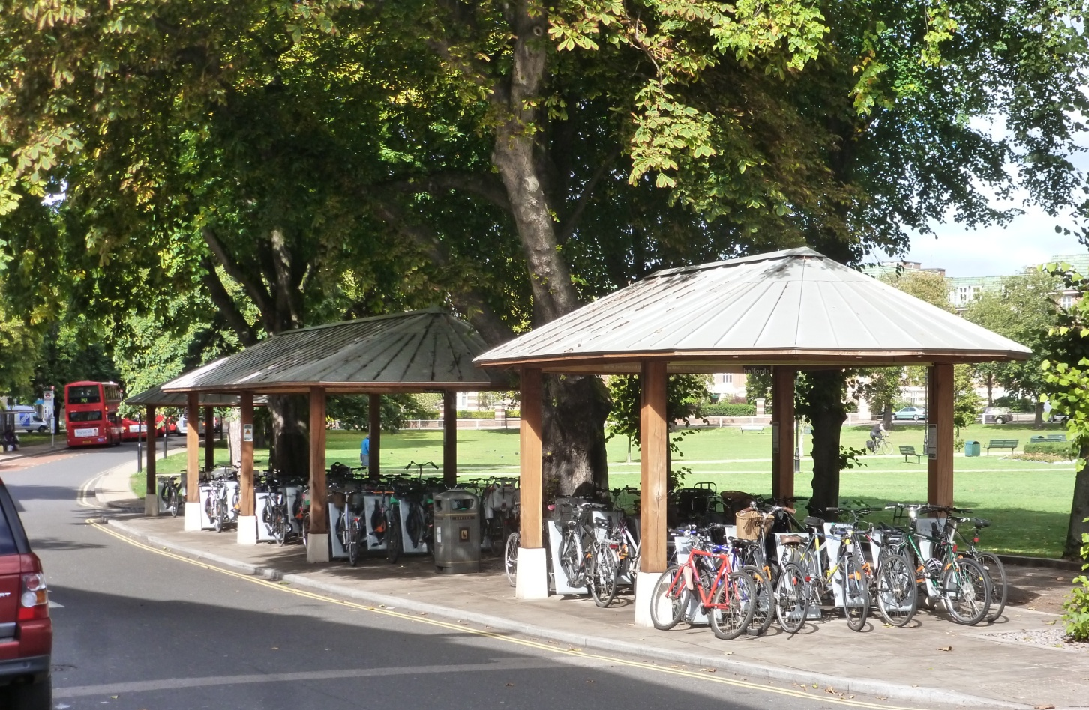
... a cycle hub for Ealing Broadway Station ...

Slide 13
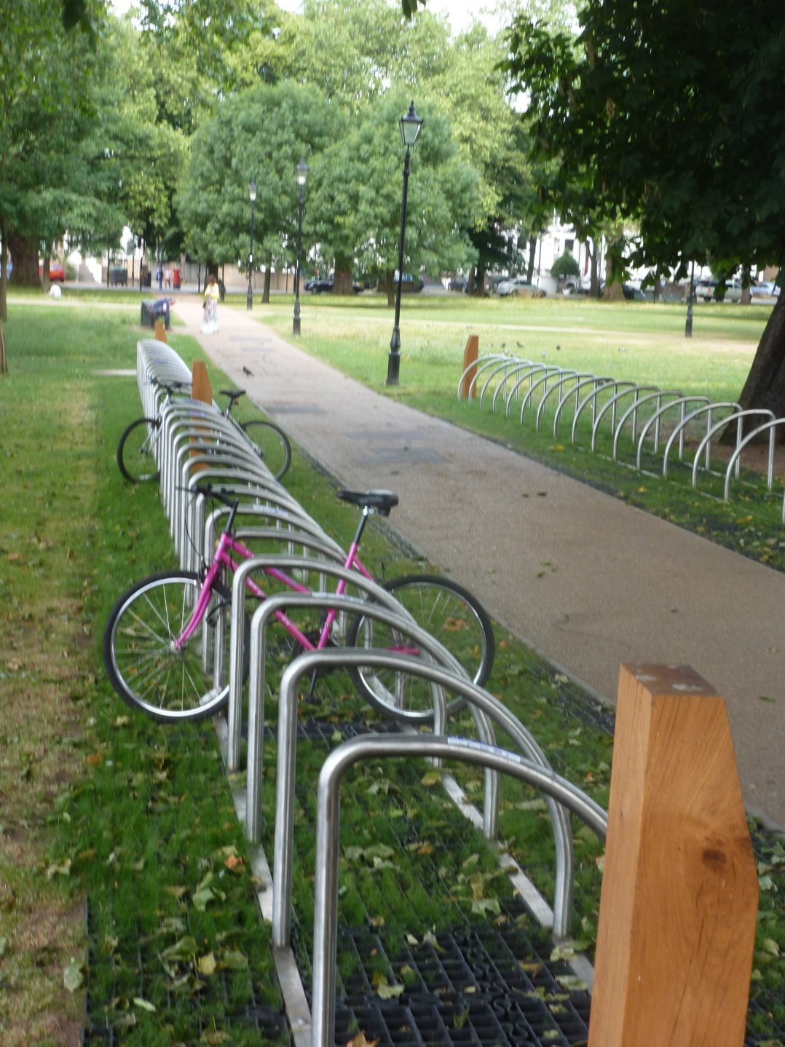
... and stands for 110 bikes ...
Keeping Haven Green at the Heart of Ealing

Slide 14
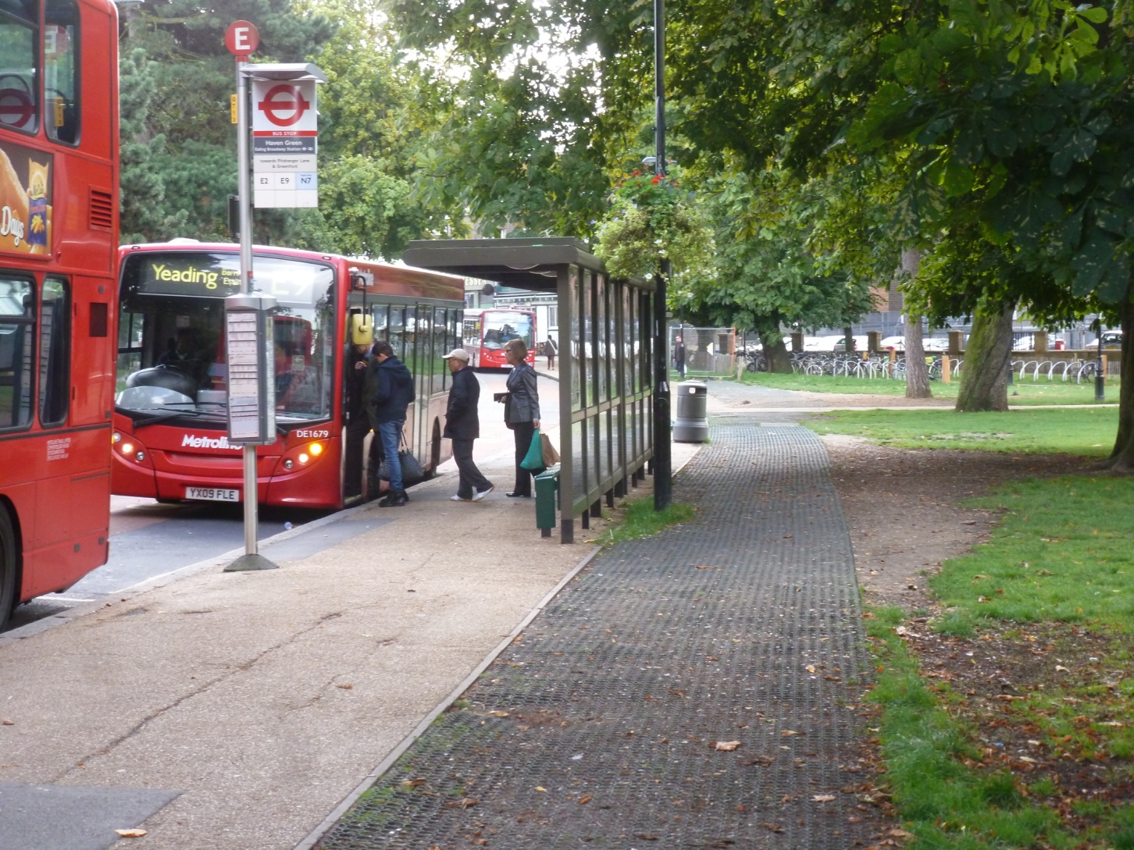
... while bus stops cause grass erosion

Slide 15
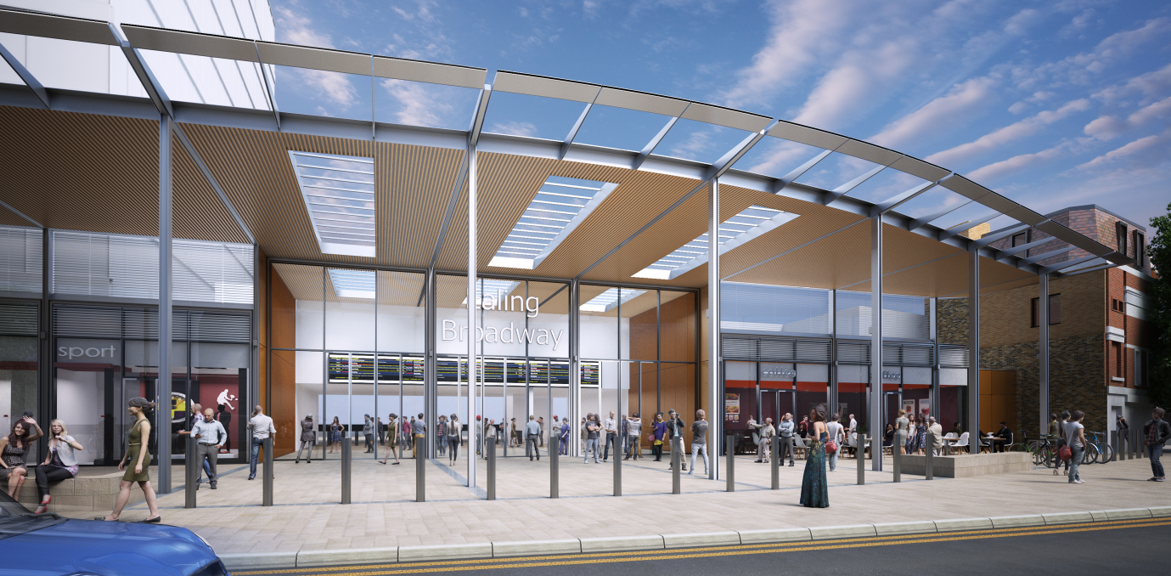
Crossrail will intensify the pressures
45% forecast growth in peak hour passengers
More buses, more pedestrians, more taxis, more cycle parking
LBE already applied to widen footpaths

Slide 16
PINS Inquiry in September 2014
FoHG wants:
Recognition of the value of the Green as open space that existing and future generations can enjoy
An alternative to piecemeal encroachment
A plan for the Green that balances all needs
Partnership working between the Council and local groups

Slide 17
visit us at: http://www.friendsofhavengreen.com
email: willdfrench@btinternet.com

