Slide 1
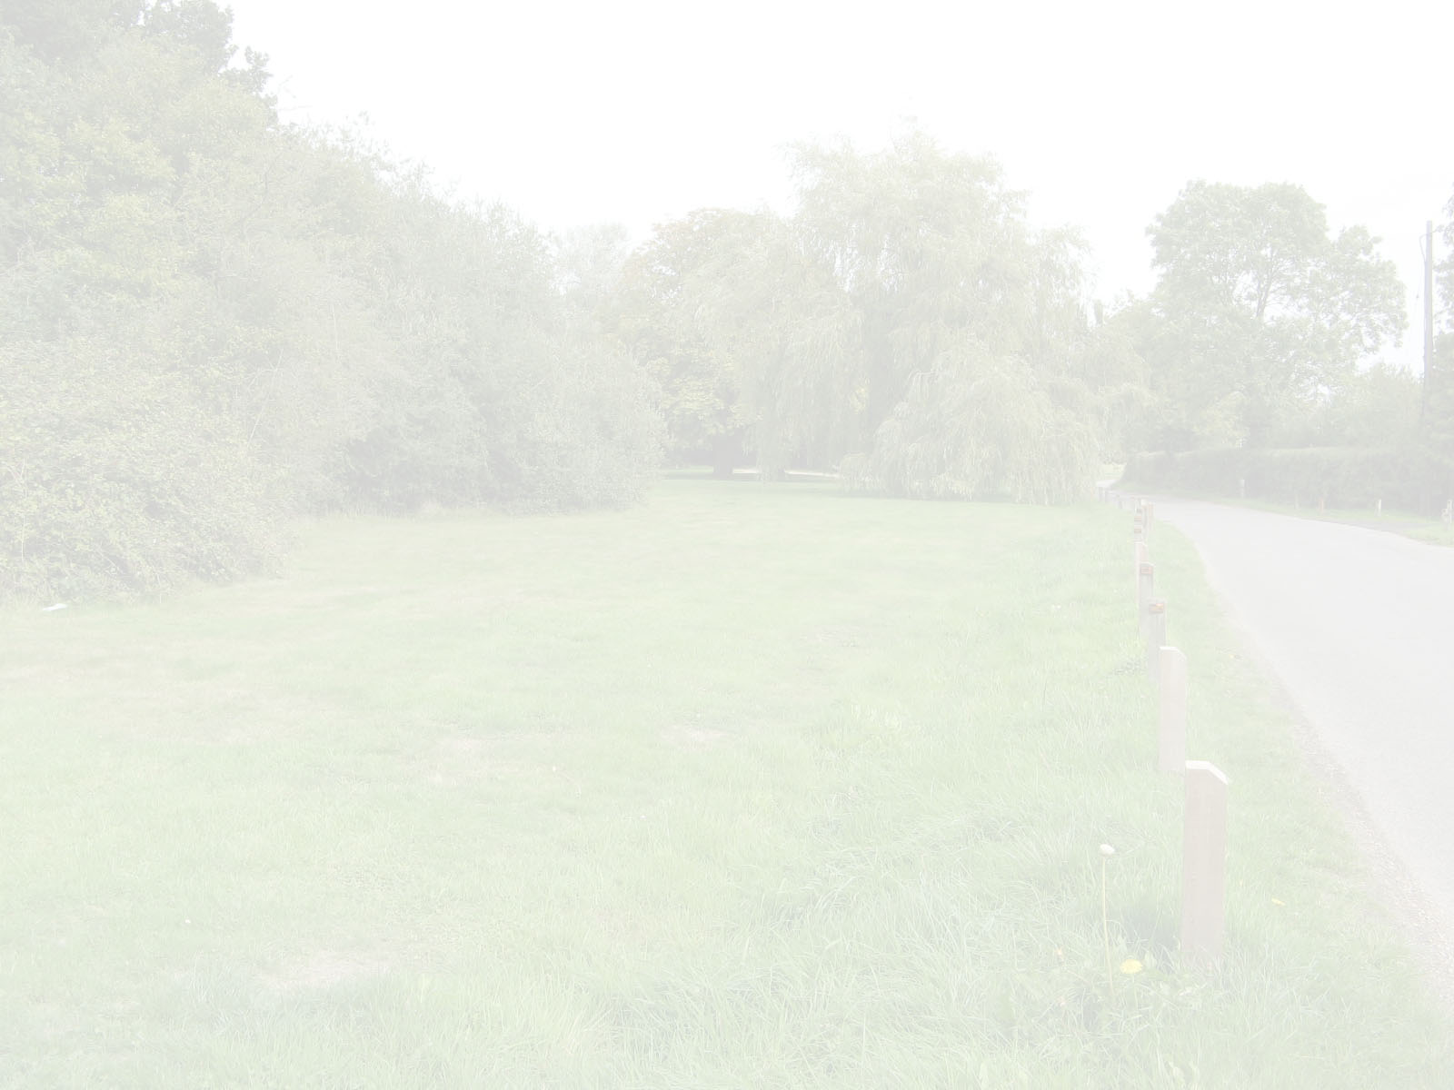
An overview of neighbourhood planning and protection of open space

Slide 2
Introduction
Current situation
Report by Turley March 2014 ‘suggests a potential conflict between localism and the positive presumptions for growth that underpin government policy’.

Slide 3
Neighbourhood plans: why?
Require a significant commitment in terms of time and energy
Financial costs
Taking tough and even controversial decisions
Nearly 1000 parish councils and neighbourhood forums have started the process
Need to clarify what a neighbourhood plan is and what it can and cannot do

Slide 4
Neighbourhood planning
Localism Act 2011 (November)
New rights and powers to allow local communities to shape new development
Taken forward by town/parish councils or neighbourhood forums
Establish general planning policies for the development and use of land
Neighbourhood development orders – no need for planning application

Slide 5
Conditions
Must be legally compliant
Must have regard to national planning policy
Must be in general conformity with strategic policies in the local development plan
Must be compatible with EU obligations and human rights requirements

Slide 6
Process
Neighbourhood development plans or orders do not take effect unless there is a majority of support in a referendum
Independent person checks it meets the conditions
Local planning authority under duty to bring them into force

Slide 7
Other Options
Community Right to build
Community infrastructure levy
New homes bonus scheme

Slide 8
What goes in a plan?
A wide range of social, economic and environmental issues arising from use and development of land
Those preparing the plan decide its content
Cannot deal with non-planning matters
Aims and visions

Slide 9
Environment
Identify specific sites of local importance
Character, location
Highlight areas to be protected from development

Slide 10
Examples
Broughton Astley, Ascot, Sunningdale, encourage formation of ‘green corriders’
Resist development that would reduce the gap between residential developments/villages
Provide walkways, cycle routes to link up open spaces
Much Wenlock: retain features of high conservation landscape
Exeter St James: prohibits developments resulting in loss of biodiversity unless compensated to bring net enhancement overall
Flood risk

Slide 11
Other issues
Housing
Economy
Community
Traffic management

Slide 12
Process
Community engagement and evidence base
Submitting draft plan
Six weeks consultation period
Independent examination
Referendum

Slide 13
Cost
Varies according to complexity
Government estimates between £17,000 to £63,000
Evidence emerging suggests as high as £100,000
The local planning authority has to pay for and arrange the independent examination of the draft plan
Parish council/neighbourhood forum must pay for consultation events, commissioning, additional evidence, printing costs

Slide 14
Funding
Department for Communities and Local Government (DCLG) will provide up to £50 million until March 2015
Funding available for planning authorities to support parish councils
New programme launched 15 April 2013 – grant payments and direct support for communities

Slide 15
Local Green Space
Designation – what is it?
The National Planning Framework (NPPF), published by the Department for Communities and Local Government in March 2012, sets out the government’s planning policies for England.
Paragraphs 76 to 78 introduce a new Local Green Space designation (LGS) to protect local green areas of particular importance to local communities.

Slide 16
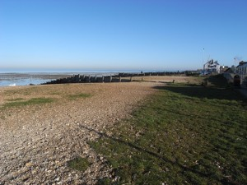
Local Green Space
Designation – what is it?
                This will enable communities, in particular circumstances, to identify and protect areas that are of value to them through local and neighbourhood plans.
                Whitstable Beach
Once designated, the LGS is subject to the same strong development restrictions as Green Belt, and new development here is ruled out other than in special circumstances.

Slide 17
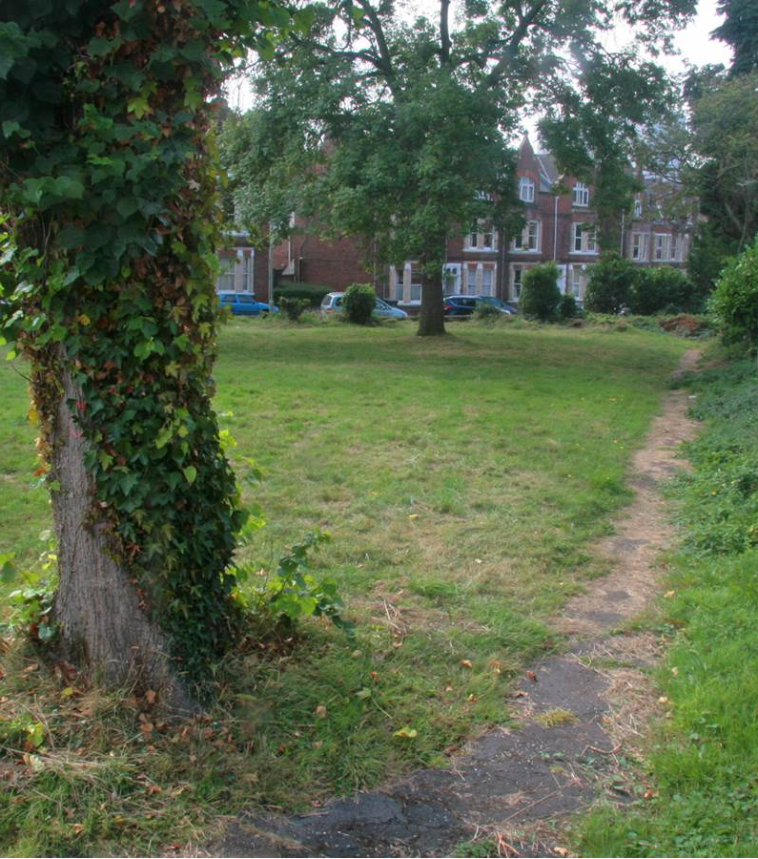
Local Green Space
Designation
The LGS is designated by the planning authority (borough, district, metropolitan or other unitary authority). Local people need to lobby the authority to designate LGS, based on the criteria.
Needs to satisfy the following criteria:
  to be reasonably close proximity to the community it serves;
  demonstrably special to a local community;
  local in character, not an extensive tract of land.
Exeter St James

Slide 18
Process
There is no prescribed process.
Some councils allow submission of areas for the local plan process when they publish allocation of sites plans or policies. Otherwise sites can be submitted through the neighbourhood plan process.

Slide 19
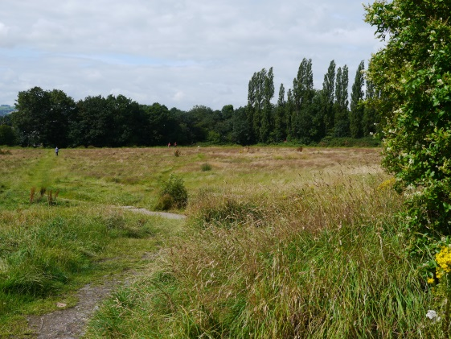
Case Studies
Whitstable Beach, Kent
Sheepbridge Fields,
Chesterfield, Derbyshire
Bourton-on-the-Water, Gloucestershire

Slide 20
New Planning Guidance
March 2014 the Department of Communities and Local Government launched a web-based planning practical guide. Old planning policy documents – such as PPG17 Open Space, Sport and Recreation have been cancelled.
http://planningguidance.planningportal.gov.uk/blog/guidance/open-space-sports-and-recreation-facilities-public-rights-of-way-and-local-green-space/

